Slide 1
UNIVERSITY INSTITUTE OF COMPUTING
MASTER OF COMPUTER APPLICATIONS
Design and Analysis of Algorithms
24CAT-611
UNIT-3
DISCOVER . LEARN . EMPOWER

Slide 2
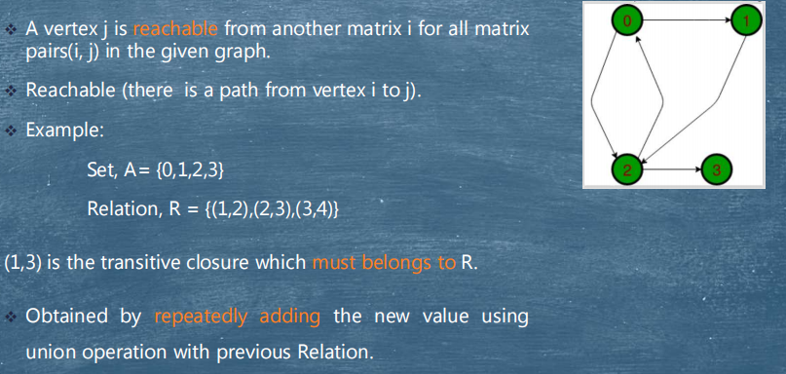
Transitive Closure

Slide 3
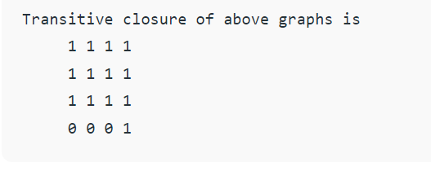
Transitive Closure
Given a directed graph, find out if a vertex j is reachable from another vertex i for all vertex pairs (i, j) in the given graph. Here reachable mean that there is a path from vertex i to j. The reach-ability matrix is called the transitive closure of a graph

Slide 4
Transitive Closure
The graph is given in the form of adjacency matrix say ‘graph[V][V]’ where graph[i][j] is 1 if there is an edge from vertex i to vertex j or i is equal to j, otherwise graph[i][j] is 0. Floyd Warshall Algorithm can be used, we can calculate the distance matrix dist[V][V] using Floyd Warshall, if dist[i][j] is infinite, then j is not reachable from i. Otherwise, j is reachable and the value of dist[i][j] will be less than V.

Slide 5
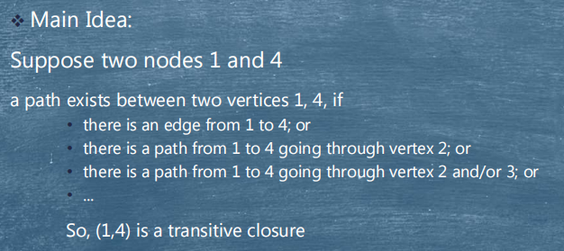
Warshall Algorithm

Slide 6
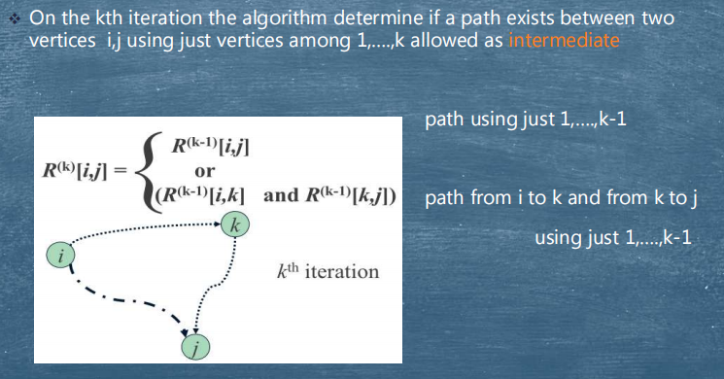
Warshall Algorithm

Slide 7
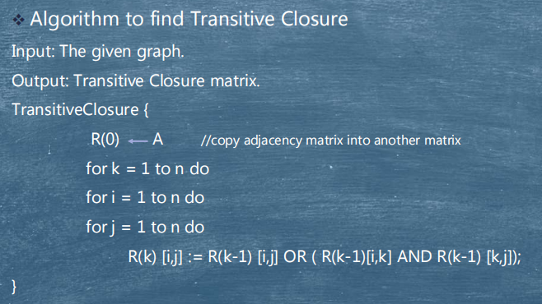
Warshall Algorithm : Transitive Closure

Slide 8
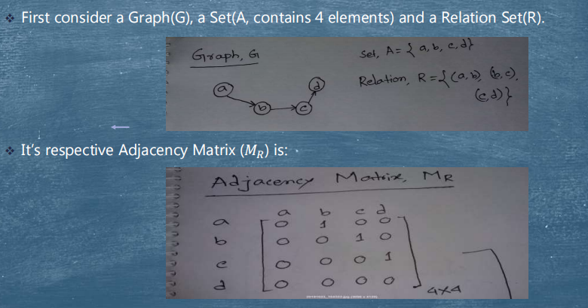
Working Procedure

Slide 9
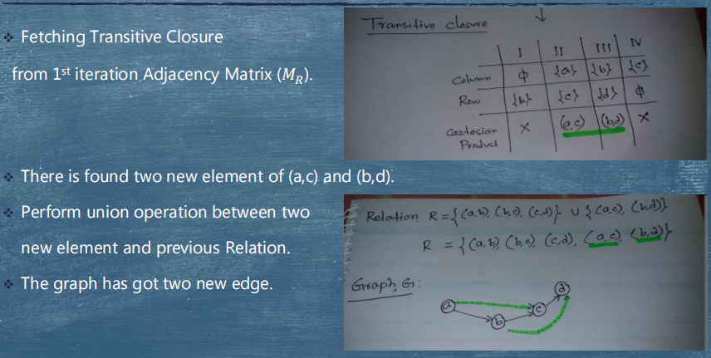
Working Procedure

Slide 10
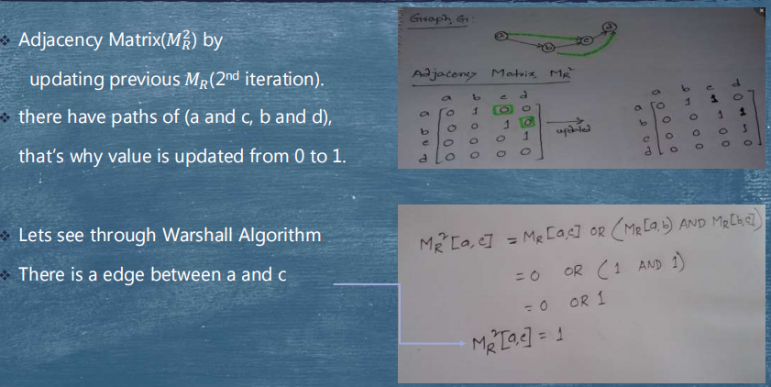
Working Procedure

Slide 11
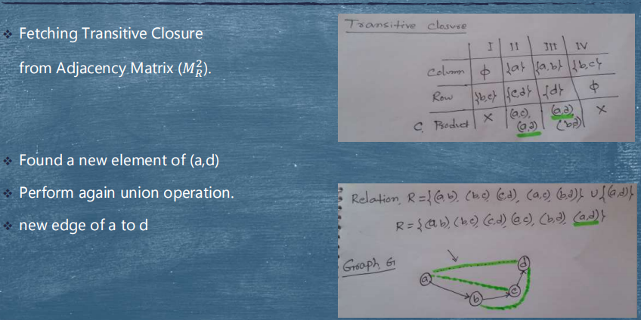
Working Procedure

Slide 12
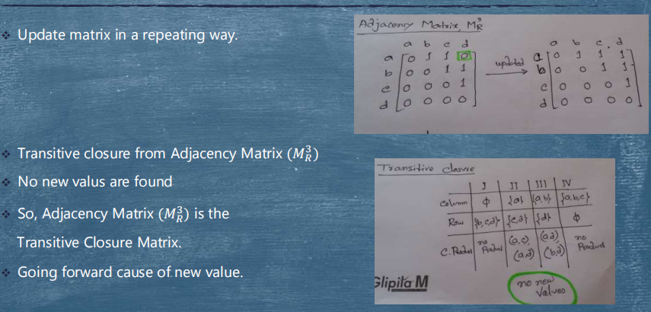
Working Procedure

Slide 13
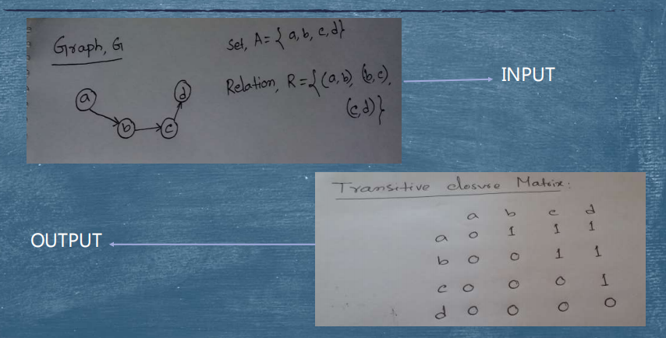
Result

Slide 14
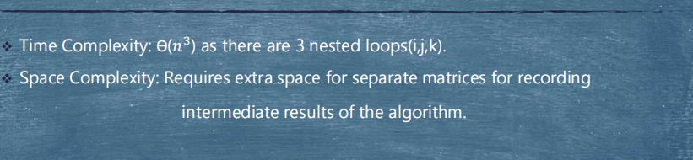
Complexity

Slide 15
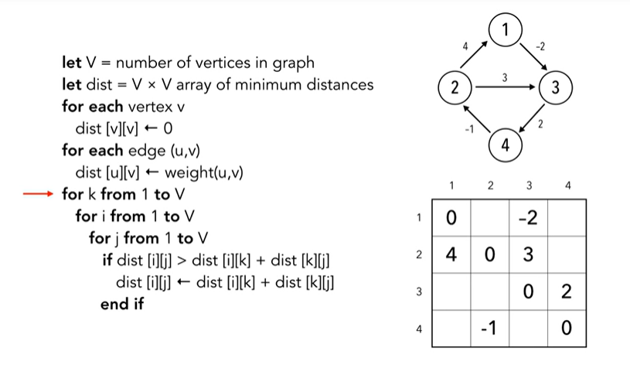
Pseudocode Warshall’s Algorithm

Slide 16
1) https://www.tutorialspoint.com/data_structures_algorithms/divide_and_conquer.htm 2) Data Structures and Algorithms made easy By Narasimha Karumanchi. 3) The Algorithm Design Manual, 2nd Edition by Steven S Skiena 4) Fundamentals of Computer Algorithms - Horowitz and Sahani
References

Slide 17
THANK YOU

